Slide 1
Microsoft HoloLens

Slide 2
INTRODUCTION
Microsoft HoloLens is the first holographic computer powered by Windows 10
It is completely unattached – Connected with Wi-Fi
The device allows users to pin holograms in his physical environment
Supports Augmented Reality

Slide 3
Augmented Reality vs Virtual Reality
Virtual Reality: Tricks your eyes into thinking that you are some where else
Augmented Reality: This can show the real world around wearer with graphic overlaid
AR can act like VR (no transparency to real world), VR cannot act like AR. Basically, Augmented Reality = VR + Google Glass

Slide 4

What is a Hologram?
A three dimensional image formed by the Interference of light beams from a laser or other light source
A hologram is an object like any other object in real world. Instead of being made of physical matter, a hologram is made entirely of light

Slide 5
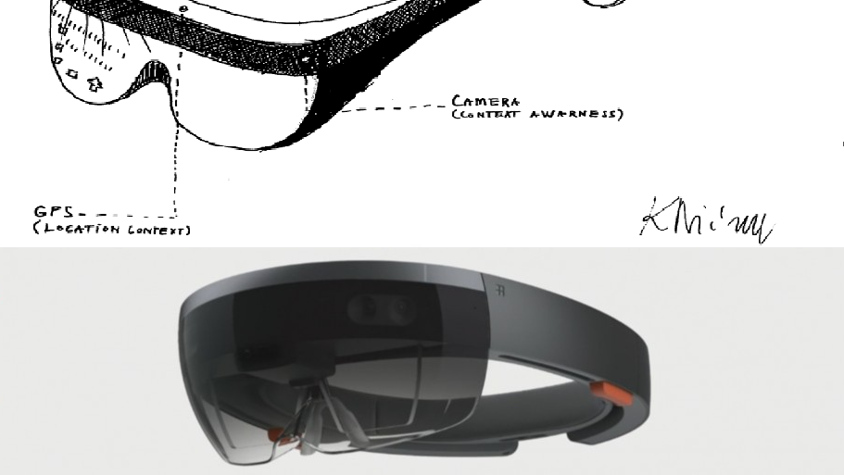
HoloLens Design
Integrated Day and Night depth camera – Detects hand movements
Sensors (18) – IMU, Motion, Camera, Depth Camera, Microphones, Ambient Light sensor and some trackers
Computer – CPU (Intel Atom), GPU, battery, HPU (Holographic) – The HPU receives information from inertial measurement unit (IMU) which includes accelerometer, gyroscope, magnetometer and combines this with head tracking camera
Lenses – Nano Projectors with Light Engine
Buttons – Volume & Contrast
Vents

Slide 6
Working of Microsoft HoloLens?
Microsoft HoloLens has user interface, so it takes voice, gaze and gestures as input commands. It has sound system built-in so that the users can listen.
The projection of hologram: For projection, HoloLens uses the HUE(head up display) method with the help of two nano projectors. The device will reflect the image as light on users eye
To create a HoloLens image, light particles bounce around millions of times in the so called light engine of the device

Slide 7
Developing HoloLens Application: Tools
Visual Studio 2017 or Visual Studio 2015 with Update 3 - Navigate to the Universal Windows Platform development and choose Game Development with Unity
HoloLens Emulator & Holographic Template – The emulator allows you to run apps on Windows Holographic in a virtual machine without a physical HoloLens. This package includes holographic DirectX project templates for Visual Studio. The System must support Hyper-V for the Emulator installation to succeed
Unity 5.6 or Unity 2017.1 – Build a holographic application

Slide 8
Development : System Requirements
HoloLens Emulator Application
64 bit Windows 10 Pro, Enterprise or Education (The Home edition does not support Hyper-V or HoloLens Emulator)
64 bit CPU
8 GB of RAM or more
GPU (The emulator might work with an unsupported GPU, but will be significantly slower) – DirectX 11.0 or later, WDDM 1.2 driver or later
Immersive Headset Development:
Dual Core with Hyper-threading
GPU: NVIDIA GTX 965M, AMD RX 460M (2GB) on Notebooks/Laptops
>10GB space

Slide 9
References & Useful Links:
https://developer.microsoft.com/en-us/windows/mixed-reality
https://www.youtube.com/watch?v=pLd9WPlaMpY
https://hololens.reality.news/how-to/hololens-dev-101-build-basic-hololens-app-minutes-0175021/
https://www.youtube.com/channel/UCT2rZIAL-zNqeK1OmLLUa6g
https://developer.microsoft.com/en-us/windows/mixed-reality

Slide 10
HoloLens Tour:
Video Tour

Slide 11
THANK YOU

